Slide 1
Reaching to AWS Console and Try Amazon Comprehend and Rekognition
By
Burak G.

Slide 2
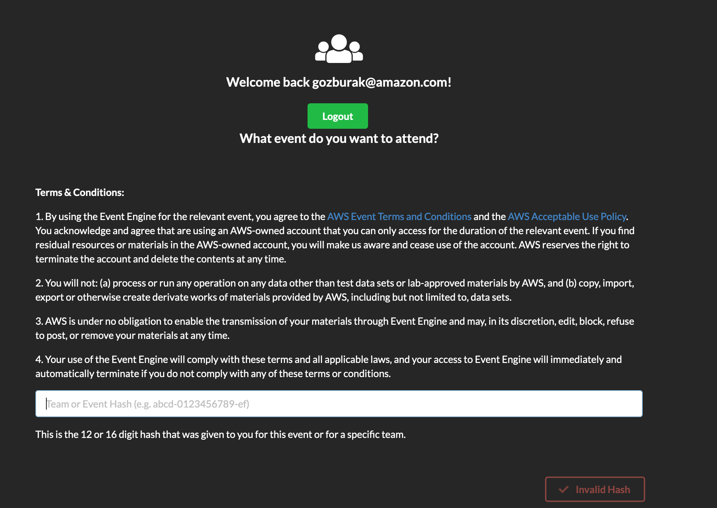
Copy-paste:
2164-1aa2e13114-b2

Slide 3
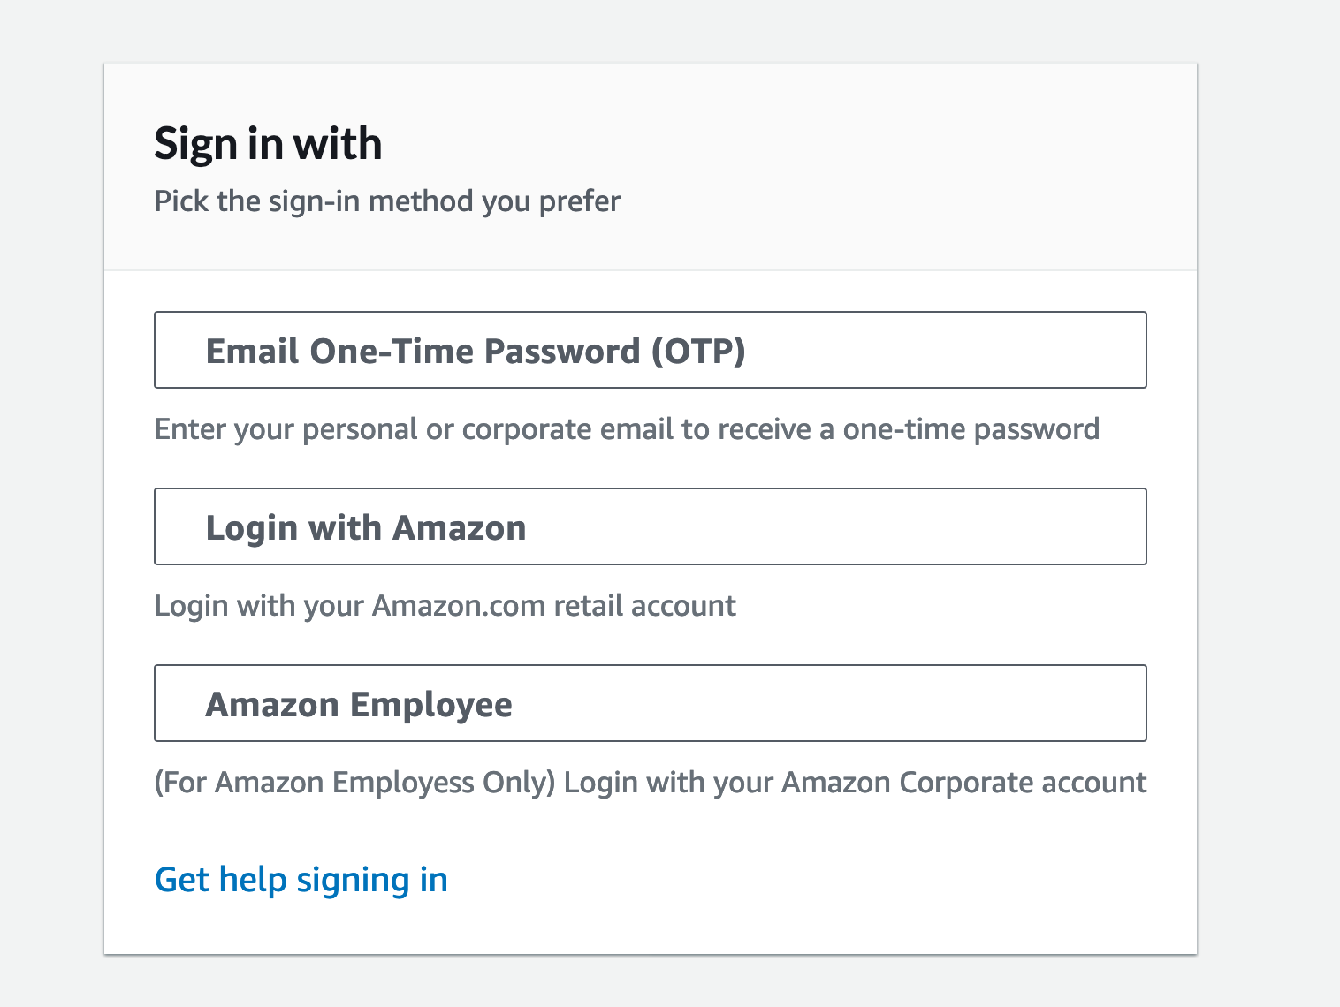
It will give you a one time password sent to your email

Slide 4
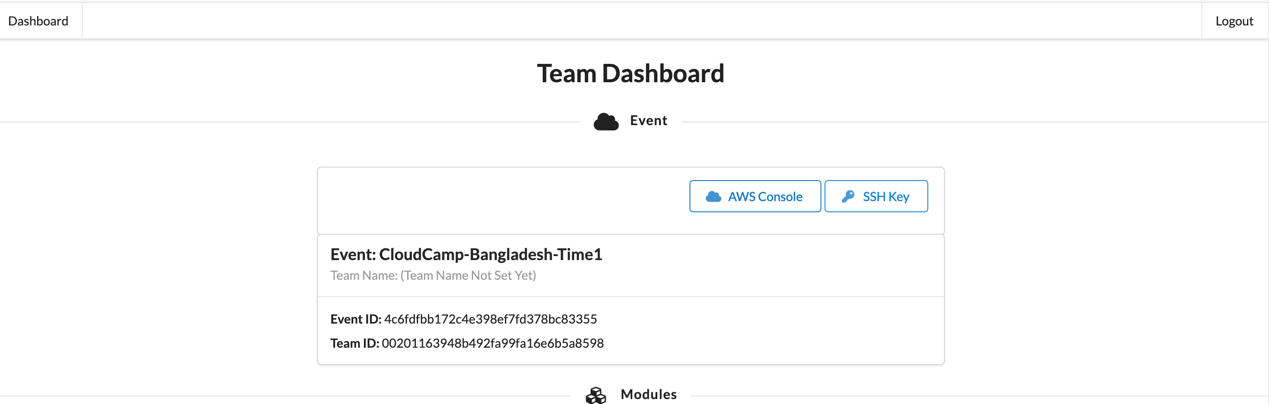
Click “AWS Console”

Slide 5
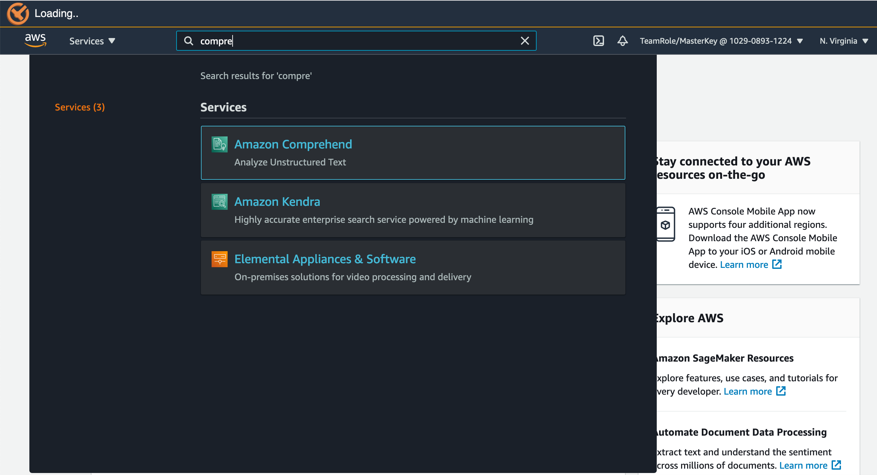
Type Comprehend and click to it

Slide 6
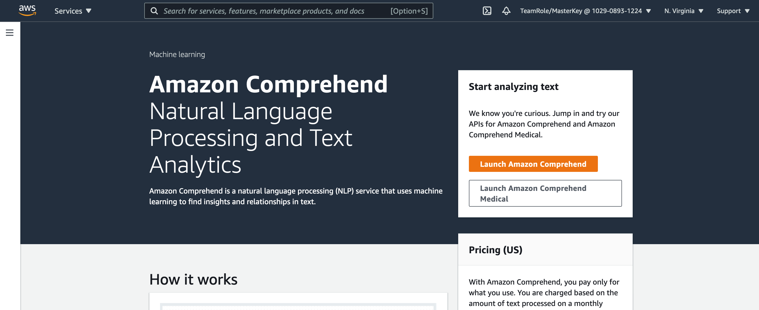
Click here

Slide 7
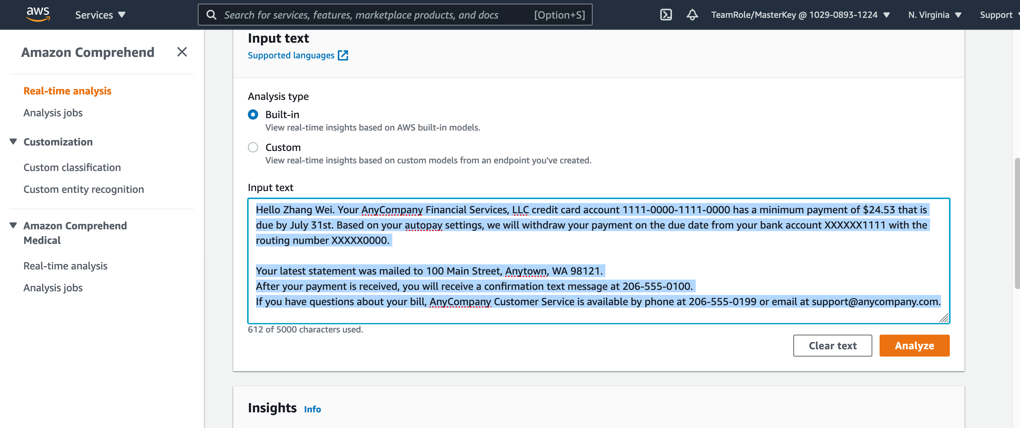
Go to “Real-time analysis” and Type your text
And click “Analyze” play with Insights

Slide 8
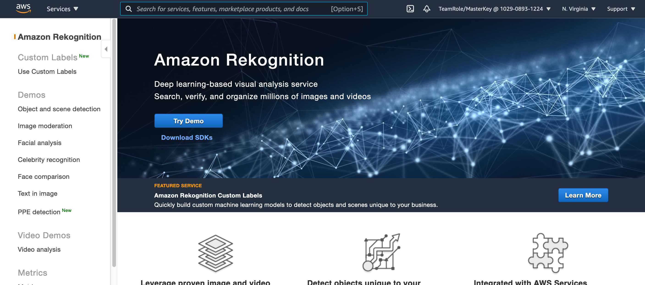
You can do the same with Amazon Rekogniton. Navigate to Amazon Rekognition on console
Try Demo!

Slide 9
